Slide 1

Essential Health Benefits in Texas
June 5, 2012
Stacey Pogue, Senior Policy Analyst, pogue@cppp.org
Center for Public Policy Priorities
(512) 320-0222 – www.cppp.org
Notes:
1

Slide 2
If joining on the phone:
All materials available at www.cppp.org under the events tab
Please keep your line muted when not asking questions
Please do not put us on hold!

Slide 3
Essential Health Benefits (EHB)
Established by Affordable Care Act
New “floor” for coverage to ensure health insurance policies have comprehensive benefits
Take effect in 2014

Slide 4
EBH requirements in the ACA
Must include 10 categories of services:
  Ambulatory Patient Services,
  Emergency Services,
  Hospitalization,
  Maternity and Newborn Care,
  Mental and Behavioral Health Services, including Drug Treatment,
  Prescription Drugs,
  Rehabilitative and Habilitative services and Devices,
  Laboratory Services,
  Preventive and Wellness services and Chronic Disease Management, and
  Pediatric Services including Dental and Vision Care.

Slide 5
EBH requirements in the ACA (cont.)
Scope must equal a “typical employer plan”
Cannot discriminate based on age, disability, or expected end of life
Takes into account needs of diverse segments of the population
Preventive care services with no co-pay incorporated to EHB
Mental health parity apply to EHB

Slide 6
Who will the EHB apply to?
People who buy insurance in the individual market (not through an employer), both inside and outside the exchange.
Small employers (up to 50 employees in 2014), both inside and outside the exchange.
EHB do not apply to:
  Grandfathered plans (in existence as of March 2010 with no significant changes)
  Plans for larger employers (including self-insured plans).

Slide 7
Who will the EHB apply to?
Medicaid coverage offered to newly eligible adults in 2014 (up to 133% of the federal poverty level) must have EHB.
The Basic Health Plan (like CHIP for adults), if a state chooses this option, must cover EHB too.

Slide 8
EHB = Services, not Cost-sharing
Health policies are comprised of covered services and cost-sharing (the amount you pay out-of-pocket for deductibles, copayments, and co-insurance)
EHB defines just the scope of services and the limits to services.
Cost-sharing is defined separately by “metal tiers,” platinum, gold, silver, and bronze.
Today, covered services are much more consistent across plans than cost-sharing.

Slide 9
States Select EHB Benchmark
Each state will determine EHB
States will select one plan from ten benchmark options in the existing insurance market to serve as the reference point for EHB services and limits
Benchmark options:
  3 largest small employer plans (by enrollment)
  3 largest state employee plans
  3 largest federal employee plans, or
  Largest commercial, non-Medicaid HMO in state

Slide 10
Supplementing Benchmark
State EHB benchmark must contain benefits in all 10 statutory categories.
If benchmark is missing a category, the state must supplement using the coverage from another benchmark option.
Federal guidance proposes alternate methods for supplementing habilitative, pediatric oral, and pediatric vision services, because they are covered in few plans.

Slide 11
EHB Timeline - 2012
state decision-making period
for 2014 and 2015 EHB
Jan | Feb | MAR | Apr | May | JUN | Jul | Aug | SEPT | Oct | Nov | Dec
Benchmark options based on enrollment in the first quarter of 2012
Supreme court decision expected
State EHB selection or default

Slide 12
Insurer Flexibility
Federal guidance proposes plans must provide benefits “substantially equal” to the benchmark.
Insurers can adjust benefits as long as all 10 categories are covered and the package is “actuarially equivalent” to the benchmark.
Ex: reduce physical therapy visit limit and increase occupational therapy visit limit
Consumer advocate concerns:
  Apples-to-apples comparisons impossible
  Benefits designed to discourage sick enrollees

Slide 13
Prescription Drugs Flexibility
Each plan must offer all of the classes of drugs covered by the benchmark
Each plan can design its own formulary as long as it covers at least one drug in each class
Advocates concerned that standard lacks important protections found in Medicare Part D:
  At least 2 drugs in each class
  All drugs in six “protected classes,” e.g. antidepressants and HIV treatment.

Slide 14
Steps for Building an EHB Package
Identify benchmark options
Import services and limits from chosen or default benchmark
Supplement benchmark to ensure coverage in all 10 ACA categories
Make adjustments to include any state mandated benefits

Slide 15
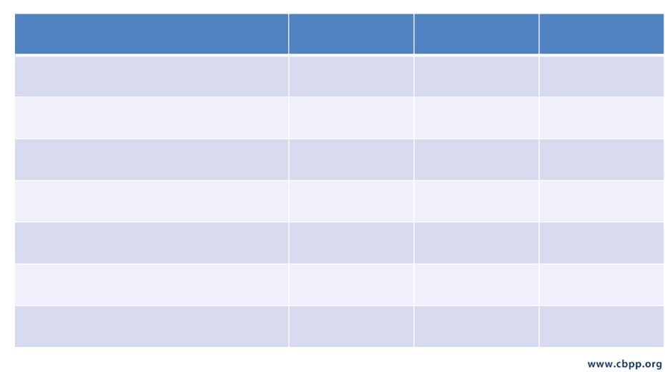
An Example
Service
Visit Limits
Dollar Limits
Cost-Sharing
Annual check-up
$0, no deductible
Visit to primary care provider
$25 copay
Home health services
90 visits per year
$0
Inpatient hospital treatment/surgery
$300 copay per stay
Outpatient hospital treatment/surgery
$125 copay
Skilled nursing facility
180-day limit
$0
Durable Medical Equipment
$7,500 per
calendar year

Slide 16

ACA’s 10 “Buckets” of Covered Services
Ambulatory
Patient
Emergency
Services
Services
Preventive and
Wellness
Maternity and
Newborn Care
Mental Health and
Substance Use
Disorder Services
Services
Rehabilitative and
Habilitative
Prescription
Drugs
Services and
Devices
Laboratory
Services
Pediatric Services,
Including Oral and
Vision
Hospitalization

Slide 17

Covered Services and Limits Become Part of EHB
• Inpatient Services COVERED
• Kidney Transplants COVERED
• Skilled Nursing Facility COVERED,
limited to 60 days a year
Hospitalization
• Obesity Surgery NOT COVERED

Slide 18

Some ACA Categories May be Missing
Ambulatory
Patient
Emergency
Services
Services
Preventive and
Wellness
Maternity and
Newborn Care
Mental Health and
Substance Use
Disorder Services
Services
Rehabilitative and
Habilitative
Prescription
Drugs
Services and
Devices
Laboratory
Services
Pediatric Services,
Including Oral and
Vision
Hospitalization
18

Slide 19
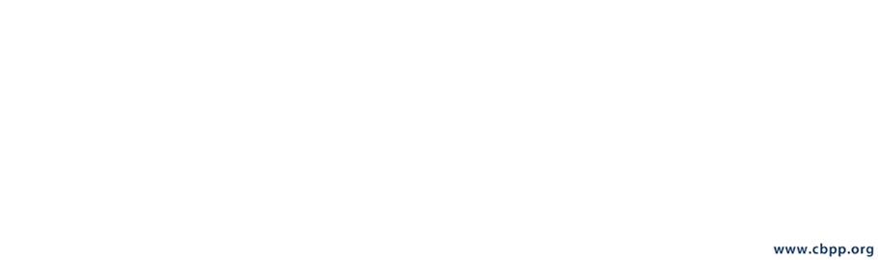
Supplementing Missing Categories: Maternity Benefits
Coverage from other benchmark options:
Purple Plan Green Plan
Pink Plan
•Labor and Delivery •Labor and Delivery
•Labor and Delivery
•Pre-Natal Care •Pre-Natal Care
•Pre-Natal care
•Pregnancy Complications
•Pregnancy Complications
•Post-Partum Care

Slide 20
Supplement Benchmark to Cover All Buckets
*Supplementing happens according to formula if default benchmark is used
Ambulatory
Patient
Emergency
Services
Services
Preventive and
Wellness
Maternity and
Newborn Care
Mental Health and
Substance Use
Disorder Services
Services
Rehabilitative and
Habilitative
Prescription
Drugs
Services and
Devices
Laboratory
Services
Pediatric Services,
Including Oral and
Vision
Hospitalization
20

Slide 21
State Mandates and EHB
ACA requires that states cover the cost of any
state benefit mandates that exceed coverage in the EHB
If a state selects a benchmark that is subject to state mandates, the mandates are incorporated into the EHB
Provides strong motivation for states to choose small employer plan or commercial HMO plan
State must still address mandates for individual market plans that go beyond small employer mandates (see handout)

Slide 22
Ensure State Mandates are Covered
*Texas has some different mandates for individual and small employer insurance
Ambulatory
Patient
Emergency
Services
Services
Preventive and
Wellness
Maternity and
Newborn Care
Mental Health and
Substance Use
Disorder Services
Services
Rehabilitative and
Habilitative
Prescription
Drugs
Services and
Devices
Pediatric Services,
Including Oral and
Vision
Hospitalization
Laboratory
Services
Plus transplant donor coverage in individual market
22
22

Slide 23
Insurer Flexibility
The insurance policy you buy may have services or limits that vary from the benchmark, as long as the benefits are “substantially equal.”
• Home health services 130 visits a year
• Skilled nursing facility 60 days a year
• Home health services 80 visits a year
• Skilled nursing facility 70 days a year

Slide 24
Issues
Unclear what category some services fit into.
  Ex: should a home health benefit count as ambulatory care or rehabilitation?
What does it mean for a category to be covered? Is skimpy coverage enough?
  Physical therapy with no occupational therapy?
  Labor and delivery with no postpartum care?
How are costs of mandates in excess of EHB determined?
These may be cleared up with federal EHB rule?

Slide 25
Medicaid Benchmark
Little guidance issued so far
Coverage offered to newly eligible adults in 2014 must cover 10 EHB categories from ACA
State can have separate benchmarks for commercial coverage and Medicaid
No default option for Medicaid benchmark – must be identified with 2014 state plan changes
Must be supplemented if missing an ACA category
States can use their traditional Medicaid benefit package as the Medicaid benchmark

Slide 26
EHB Decision Points for States
Choose a benchmark or use default
What will the process be to choose? Which entity selects the benchmark?
  Guidance: can use any process/entity appropriate under state law
  In general, executive branch has authority
  Legislation may be needed in some states
Supplementing the benchmark
Treatment of mandated benefits
Engaging the public/stakeholders?

Slide 27
Information Needed for Informed
Benchmark Selection
10 benchmark options:
  U.S. HHS identifies 3 largest small employer plans and 3 largest federal employee plans. Soon?
  TDI identifies largest commercial HMO
  TDI/ERS? identifies largest state employee plans
Detailed plan documents for each option
Analysis of tradeoffs among plans*
Analysis of mandated benefits*
  TDI Rider 19 report: identify mandates that exceed EHB and cost. Due 12/31/12 or 90 days after EHB rules are final. This analysis due AFTER EHB selection?
* see examples from other states

Slide 28
Examples of Differences in Texas Benchmark Options
Differences most likely in limits and exclusions:
  Day and visit limits for physical and occupational therapy, chiropractic, skilled nursing facilities, and home health
  Exclusions for specific services – infertility, bariatric surgery, brand-name drugs.

Slide 29
Differences in Texas Benchmark Options
Service | HealthSelect | BCBS Small Employer Best Choice
Bariatric Surgery | + | -
Outpatient Mental Health | 30 Visits | No Limit
Inpatient Mental Health | 30 Day Limit | No Limit
Autism Spectrum Disorder- Applied Behavior Analysis | - | +
Hospice | Not Stated | 60 Visits
Home Health | 100 Visits | 60 Visits

Slide 30
Possible EHB Legislative Issues
Maintain and pay for or repeal mandates that exceed EHB, if any
Policies to limit or disclose insurer flexibility
Others?

Slide 31
Roles for Advocates
Respond to US HHS EHB rule
Advocate at state level for:
  An open process that allows for input from the public
  Public posting of all plan documents and analyses
  Full information on mandates before decision
  A specific benchmark option (or supplemental coverage) or more general principles
Identify how different enrollees would fare under benchmark options
Educate/engage Texans in EHB process
Session: mandates, flexibility, and others?

Slide 32
Resources
Essential Health Benefits bulletin, HHS
EHB FAQ, HHS
List of largest small employer plans by state and largest federal employee plans, HHS (not using Q1 2012 enrollment)
Essential Health Benefits in Texas, CPPP
EHB benchmark analyses from other states:
  California
  Washington
  Maine
  Michigan
  Massachusetts
  Virginia
Texas mandated benefits, TDI

Slide 33
Discussion
Plans for advocacy?
  Getting information: benchmark options, analyses, mandates
  Selection process: decision maker, public input
  Benchmark
Plans for public education?
Opportunities to coordinate?
Issues for session?

Slide 34
Use of This Presentation
The Center for Public Policy Priorities encourages you to reproduce and distribute these slides, which were developed for use in making public presentations.
If you reproduce these slides, please give appropriate credit to CPPP.
The data presented here may become outdated.
For the most recent information or to sign up for
our free E-Mail Updates, visit www.cppp.org.
© CPPP
Center for Public Policy Priorities
900 Lydia Street
Austin, TX 78702
P 512/320-0222 F 512/320-0227

